Slide 1
listen …

Slide 2
GES1011/GES1009
The Evolution of a
Global City-State

Slide 3
the World by 1250; and Temasek?

Slide 4
Question and Response

Slide 5
recap …
imagining and narrating Singapore’s past/s …

Slide 6
task for today ...
recap: a geological unfolding …
a human (and a biological unfolding) …
‘Singapore’ and the region/its neighbours …
earliest known evidence of human activity on this island …

Slide 7
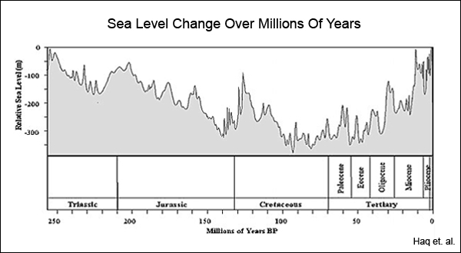
recap …

Slide 8
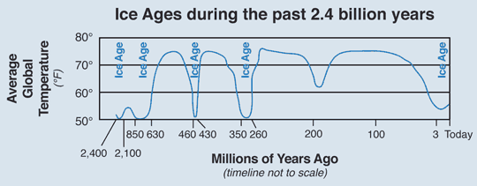
recap +…

Slide 9
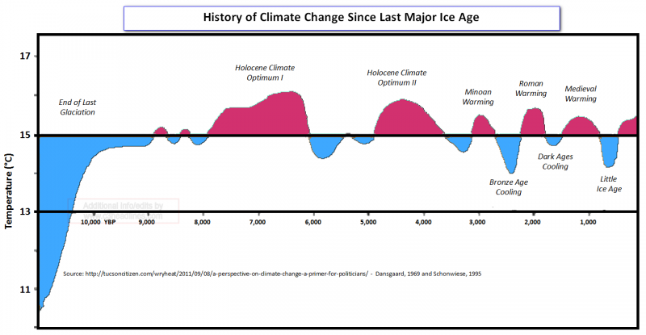
recap +: a geological unfolding …

Slide 10
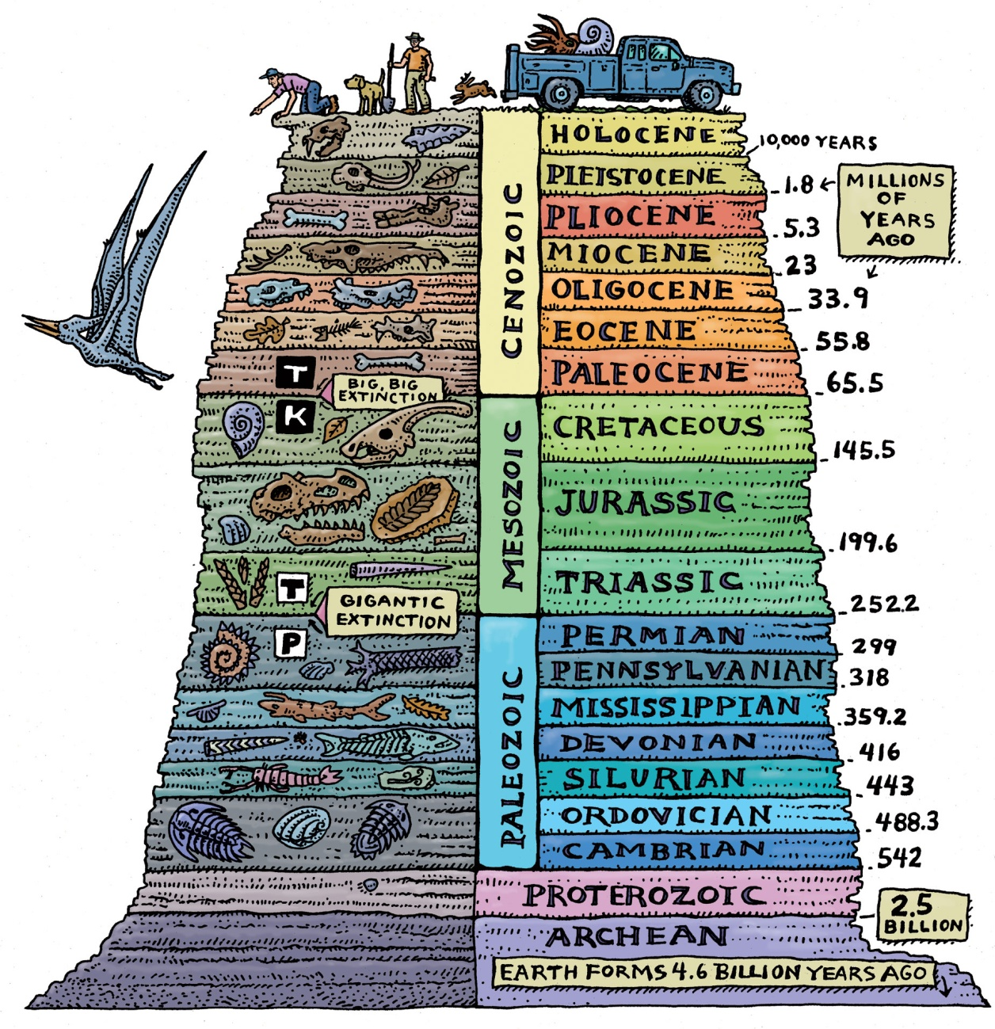
a biological unfolding …

Slide 11

a biological unfolding …

Slide 12

a biological unfolding …

Slide 13
a biological unfolding …

Slide 14
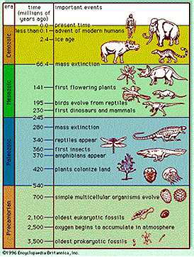
a biological unfolding …

Slide 15
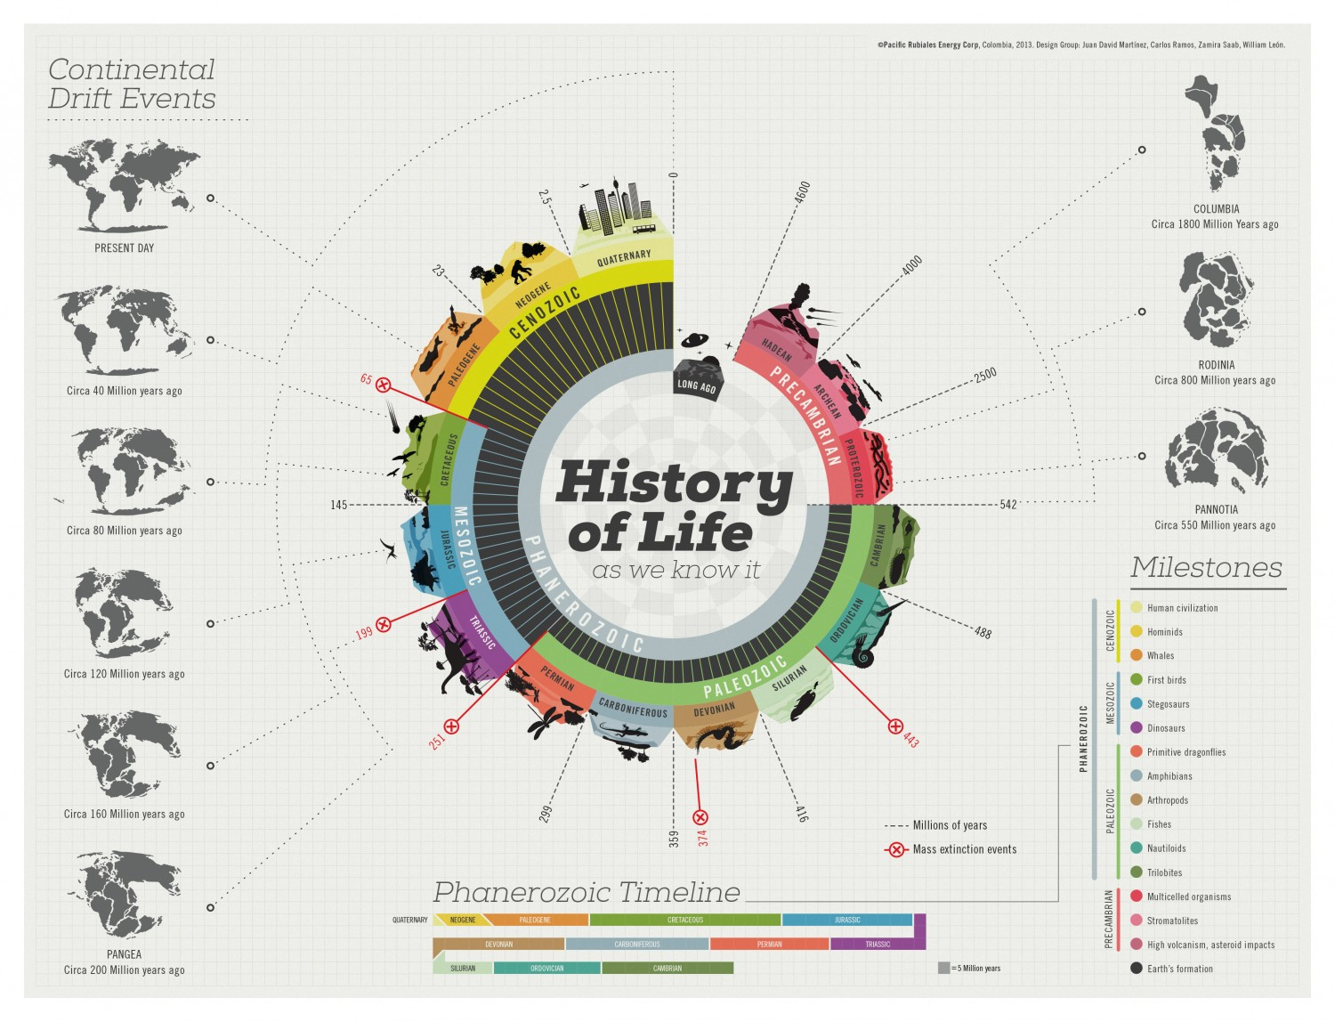
a geological and biological unfolding …

Slide 16
a biological unfolding …
watch

Slide 17
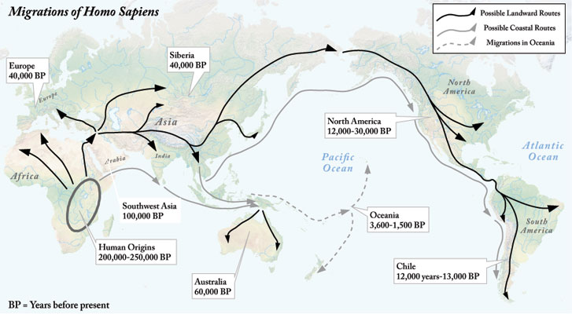
a human unfolding …

Slide 18
a human unfolding ..
as these humans left Africa (100-200,000 years ago) …
they were hunter-gatherers …
with stone tools …
and FIRE* (400,000 years ago)
but they were not agriculturalists (only 12,000 years ago) …

Slide 19
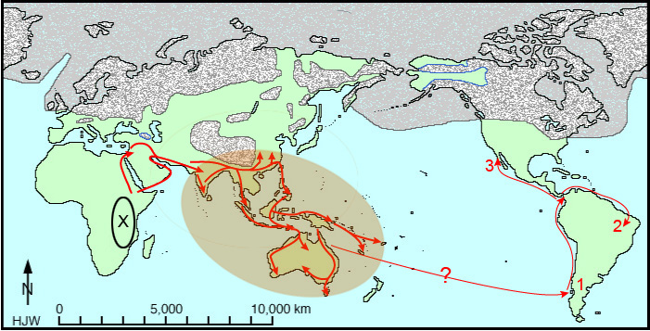
a human unfolding …

Slide 20
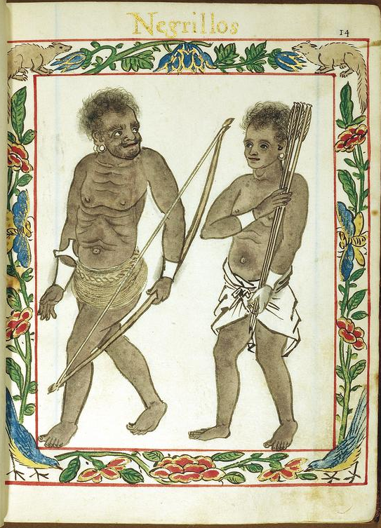
a regional human unfolding …

Slide 21
a regional human unfolding ..
Spanish drawing from 1595 …
suggesting long term human presence in the interiors of parts of SEA (mainly insular SEA) …

Slide 22
a regional human unfolding ..
the Negritos (Spanish for ‘little black people’) …
probably the earliest human migration into parts of what is now island SEA …
35-70,000 years ago …
look somewhat similar to black-skinned people from Africa: woolly hair, dark brown skin, flat noses, thick lips ...
today, living in what is the Philippines, Malaysia, Thailand and the Andaman Islands …

Slide 23
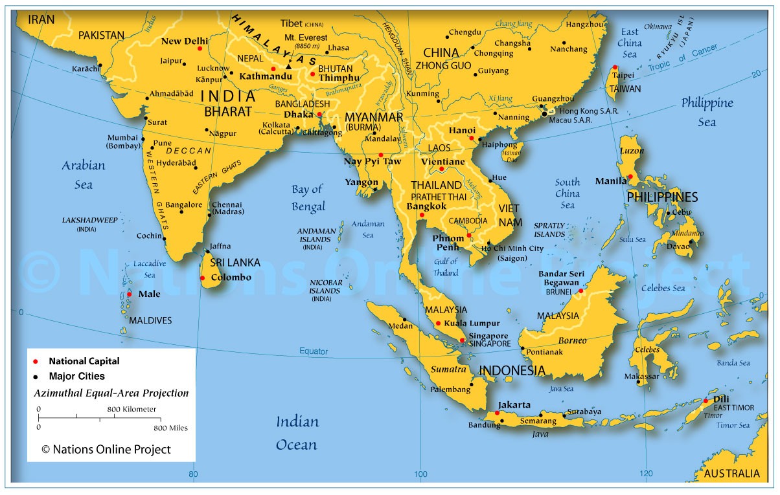
a human unfolding …

Slide 24
a regional human unfolding ..
DNA evidence links them to people groups like the Melaesians, Papuans, South Indians, even some groups in South America …
‘Negritos’ is not a label they used to call themselves …
a European (Spanish) imposed label …
no available evidence of their presence on what is now 1°09’N and 1°29’N, and, 103° 38’E and 104° 06’E …
first human beings in the neighbourhood …

Slide 25
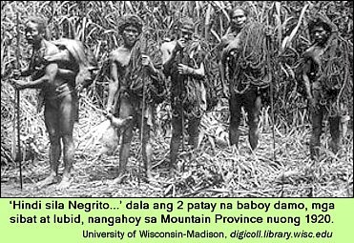
a regional human unfolding …

Slide 26
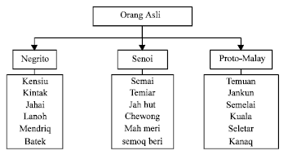
a human unfolding …

Slide 27
Question and Response

Slide 28
a regional human unfolding ..
but there is a later ‘larger scale’ significant migration of people groups …
according to scholars, based mainly on linguistic evidence (some archaeological and trade) …
into the region …
Kwa discusses this in the section entitled ‘Austronesian Connections’ (p. 11) …

Slide 29
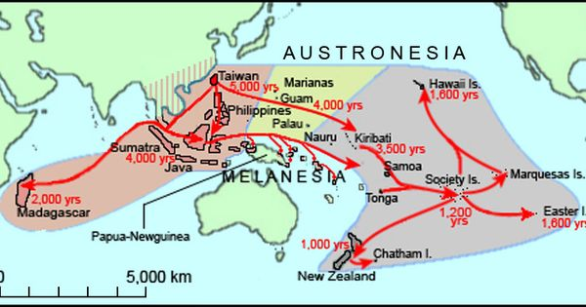
a regional human unfolding …

Slide 30
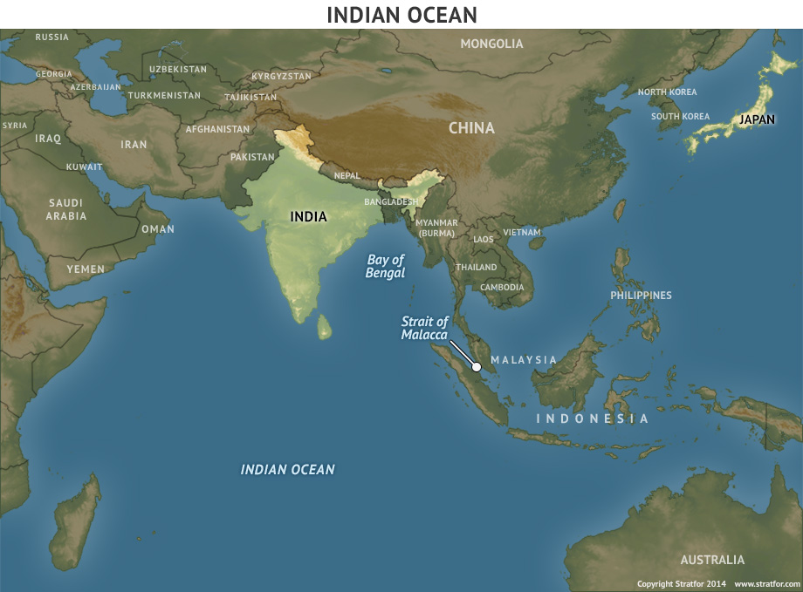

Slide 31
a regional human unfolding …
based on linguistic evidence, the Malay language that we know today can be traced back to
a larger sub-group known as the MALAYAN-POLYNESIAN subgroup …
which in turn is one of nine primary FORMOSAN subgroups …
all of which are members of the AUSTRONESIAN language family …

Slide 32
a regional human unfolding …
the recorded dispersal of Austronesian speakers and their languages suggest that they can trace links to the southern Chinese coast (6500BCE) …
and later Formosa (Taiwan)(5000-3000BCE) …
then to northern Luzon (3000-1500BCE),

Slide 33
a regional human unfolding …
to the south, east, and later south west of the SEAsian and PACIFIC ‘super-archipelago’ …
and even later, across the INDIAN OCEAN (300CE) …
to the shores of AFRICA (500CE) ….

Slide 34
a regional human unfolding …
this narrative is that of Bellwood, or what is called the Bellwood-Blust thesis …
it is the most widely accepted explanation of Austronesian dispersal …
note that this thesis does not explain presence of hunter-gatherers in SEA (Negritos) …

Slide 35
a regional human unfolding …
analysis is situated within a larger human (his)story ...
“the greatest human dispersal on record” since we left Africa …

Slide 36
a regional human unfolding …
once these people get here …
they settle (land clearing, agriculture, early trade)
from groupings …
the growth of exchange and trade networks was a consequence of growing political centralisation …
and concurrent social stratification of Austronesian communities …

Slide 37
a regional human unfolding …
as they evolved from the last stages of prehistoric tribal societies …
into chiefdoms …
leaders/council of rulers/elders/leaders emerge …

Slide 38
Question and Response

Slide 39
a regional human unfolding …
examples of the Austronesian dispersals …
Funan, a regional trade centre from the 1st to 7th centuries CE …
from Chinese records …
an apparent point of contact from trade and people flowing from China to India and back …
still no evidence of activity on what is now 1°09’N and 1°29’N, and, 103° 38’E and 104° 06’E …
a prefiguring of Singapura? …

Slide 40
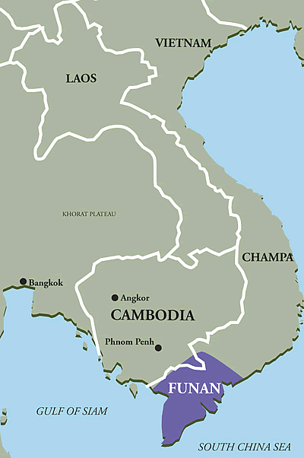
a regional human unfolding …

Slide 41
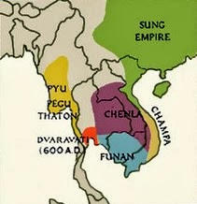
a regional human unfolding …

Slide 42
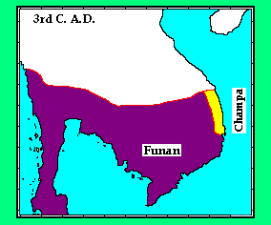
a regional human unfolding …

Slide 43
a regional human unfolding …
but contact and movement was not only about trade …
but also religion …
Buddhism was brought into the region and …
it shifted from being a “pioneer in agricultural expansion” to “a promoter of commerce” …

Slide 44
a regional human unfolding …
Buddhism’s emphasis on accumulation of wealth and its approval of interest on investments made it a favoured religion among traders … (cf Islam from later period)
initially, different nodes of trade took the form of competing harbors …
eventually, one polity emerged as the dominant entreport (Srivijaya?) whilst the others became feeder ports …

Slide 45
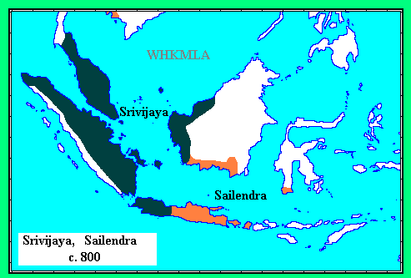
a regional human unfolding …

Slide 46
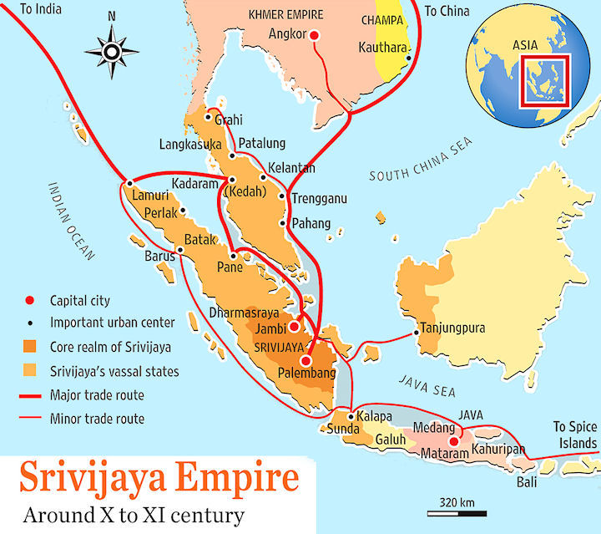
a regional human unfolding …

Slide 47
a regional human unfolding …
Srivijaya’s existence said to have commenced in the 7th century CE, enduring into 13th century CE …
yet another prefiguring of Singapore?
and now, if you notice, we are much closer to 1250* …
a somewhat arbitrarily chosen date …

Slide 48
a regional human unfolding …
and finally …
after several billion years of life on the planet …
and maybe 200,000 years of human migration …
we may have the first evidence of some human activity on what is now 1°09’N and 1°29’N, and, 103° 38’E and 104° 06’E …

Slide 49
a human unfolding on 1°09’N and 1°29’N, and, 103° 38’E and 104° 06’E …
?

Slide 50
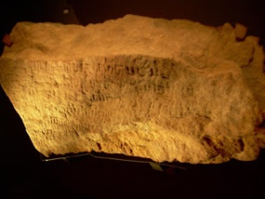

Slide 51
Singapore Stone

Slide 52
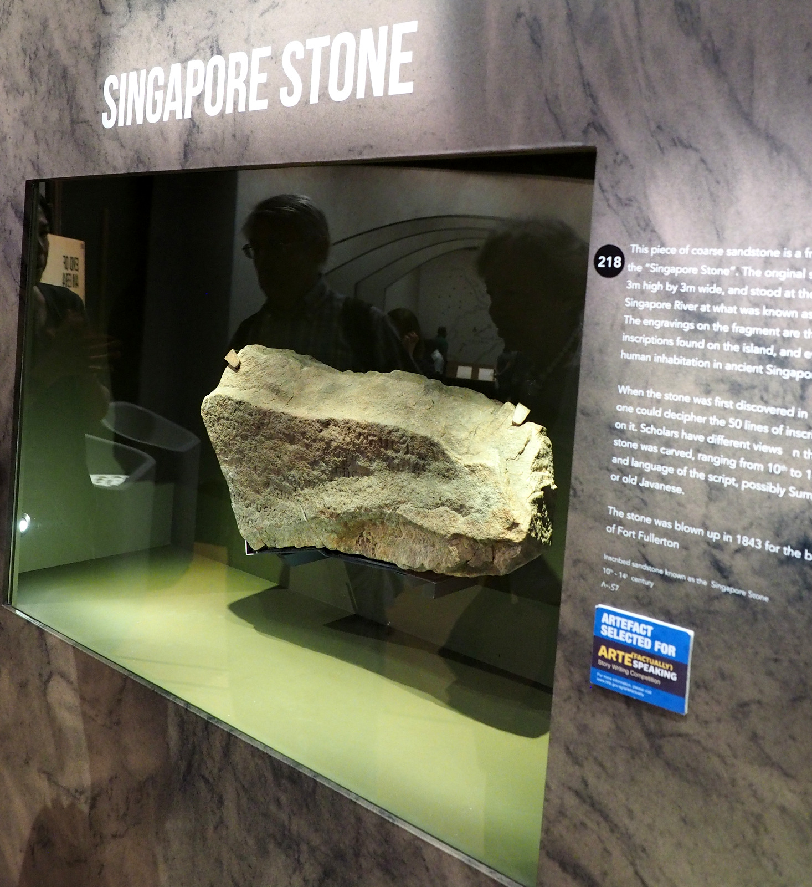
Singapore Stone

Slide 53
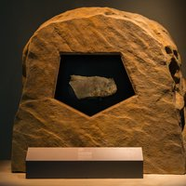
Singapore Stone

Slide 54
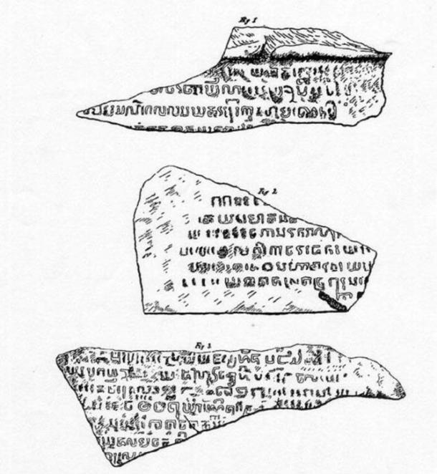
Singapore Stone

Slide 55
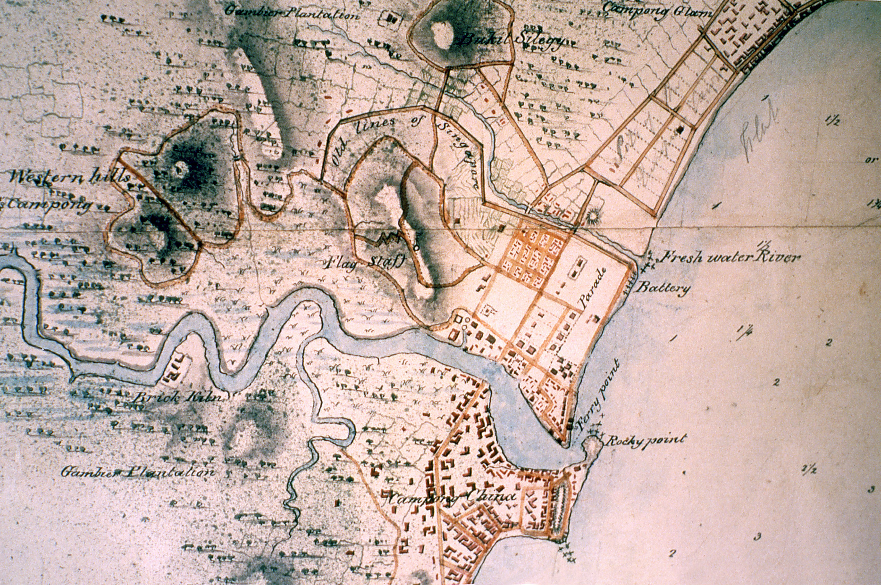
Singapore Stone

Slide 56
Singapore Stone
according to descriptions from the 1800s …
approximately 2.5 metres in height and about 2 metres across …
50 lines of engraved lettering about 2 cm in height …
what remains is about 80kgs; 37*74*15,
based on the estimated size above, it would make the original about 1.5 metric tonnes …

Slide 57
Singapore Stone
however, finally, when we are seemingly on the cusp of some exciting discovery …
we face a roadblock …
the text remains largely undeciphered …

Slide 58
Singapore Stone
scholars say Old Javanese or some form of Sanskrit …
but nobody knows …
said to date from the 13th century CE or perhaps even 11th century …
a remain of the Srivijayan era ?

Slide 59
Question and Response

Slide 60
imagining Singapore’s past …
(prequel to Tutorial 1) …
let’s exercise our historical imagination …
imagine yourself on a sea vessel …
remind yourself of the Singapore Stone’s original location …
imagine yourself countenancing it as you sail past …

Slide 61
imagining Singapore’s past …
would you notice it?
what would strike you most?
what, if anything, would it mean to you?
would you be impressed or frightened or …?
if you slowed down and stopped, would you understand it?

Slide 62
imagining Singapore’s past …
why then would it be placed there?
social signifier …
of elite literacy …
of religious or regal lineage …
of human resources (labour)…
???

Slide 63
imagining Singapore’s past …
what might it tell us about the community or society that was responsible for the inscription …
they had time to devote to inscription …
they had the relevant talent …
suggest they were past foraging for mere subsistence living …
and had sea traffic they wanted to attract, impress or influence …

Slide 64
making sense of life and life and society linked to the Singapore Stone
who was responsible for it?
when was it written?
who was/were its intended audience/s?

Slide 65
making sense of life and life and society linked to the Singapore Stone
was this Singapura ?
or Temasek ?
or something prior to both?

Slide 66
making sense of life and life and society linked to the Singapore Stone
it is very difficult to respond to these questions …
and evidence of a good general education lies in having the courage to say …
I DON’T KNOW …
and merely offering some educated guesses …
and not forgetting that you are only guessing …

Slide 67
making sense of life and life and society linked to the Singapore Stone
a lack of information marks much of human existence (past and present) …
and in responding to these inadequacies …
we need to learn to be comfortable with large amounts of ambiguity and uncertainty …

Slide 68
Question and Response

Slide 69
interpreting a globally-inflected Singaporean past …
human activity on this island may stretch beyond 700 years …
in a world connected by trade, religion (more on Islam next week) and language …
these connections have been dubbed the ‘Silk Roads’ …
by land and sea …
is this past, particularly pre-1800, part of Singapore’s story?

Slide 70
Question and Response

